Slide 1
Executive Board Meeting June 9, 2021, at 4:00 PM
2020-2021 School Year

Slide 2
AGENDA
Call to Order
Approval of Minutes: April 14th
Administration Report
Update
Treasurer’s Report
Financial Report
Check Request
President’s Report
2021-2022 Executive Board
Executive Board Report
Spirit Wear
Memberships and Incentives
Adjournment
Next Board Meeting

Slide 3
Approval of April 14, 2021, Minutes

Slide 4
ADMINISTRATION REPORT

Slide 5
Treasurer’s Report

Slide 6
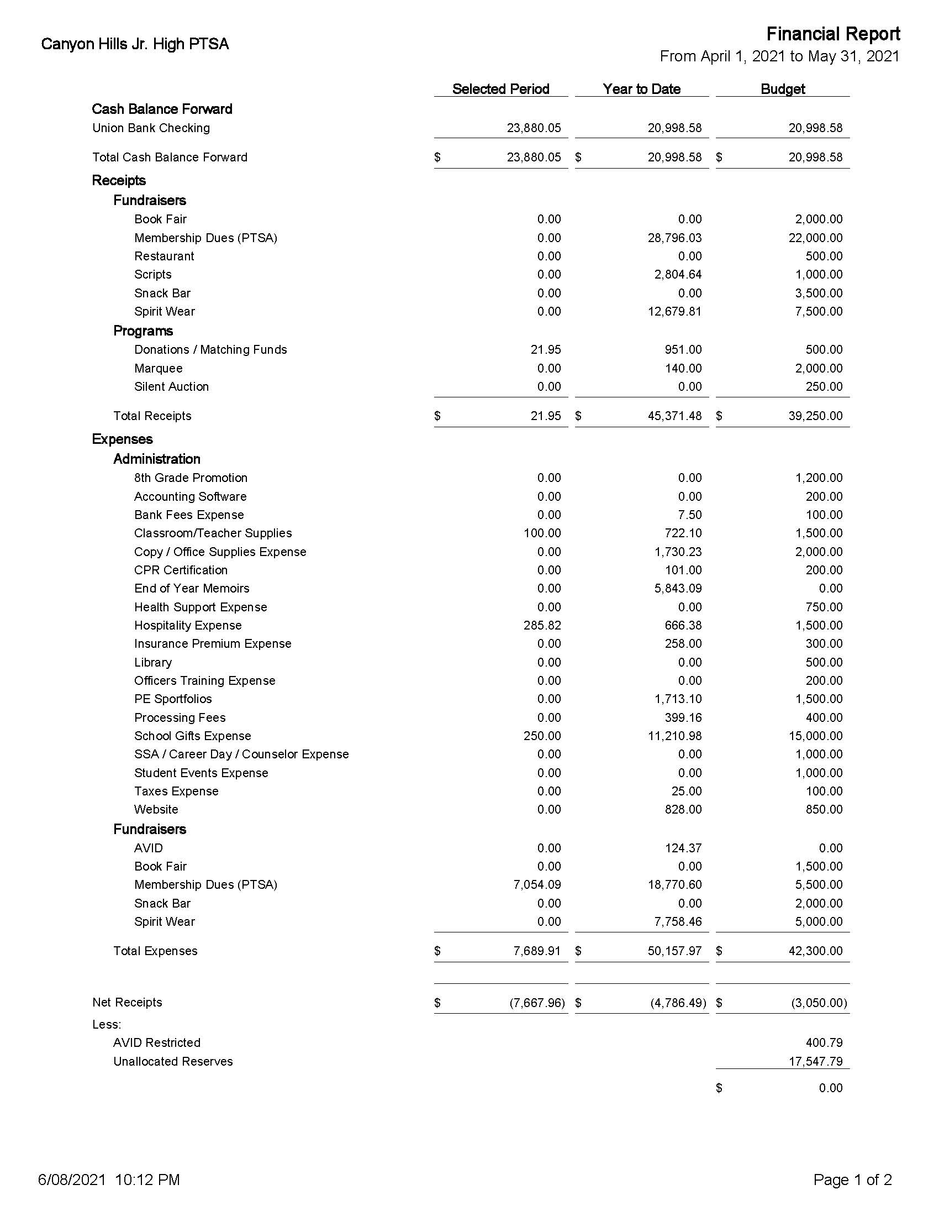
Financial Report as of May 31, 2021

Slide 7
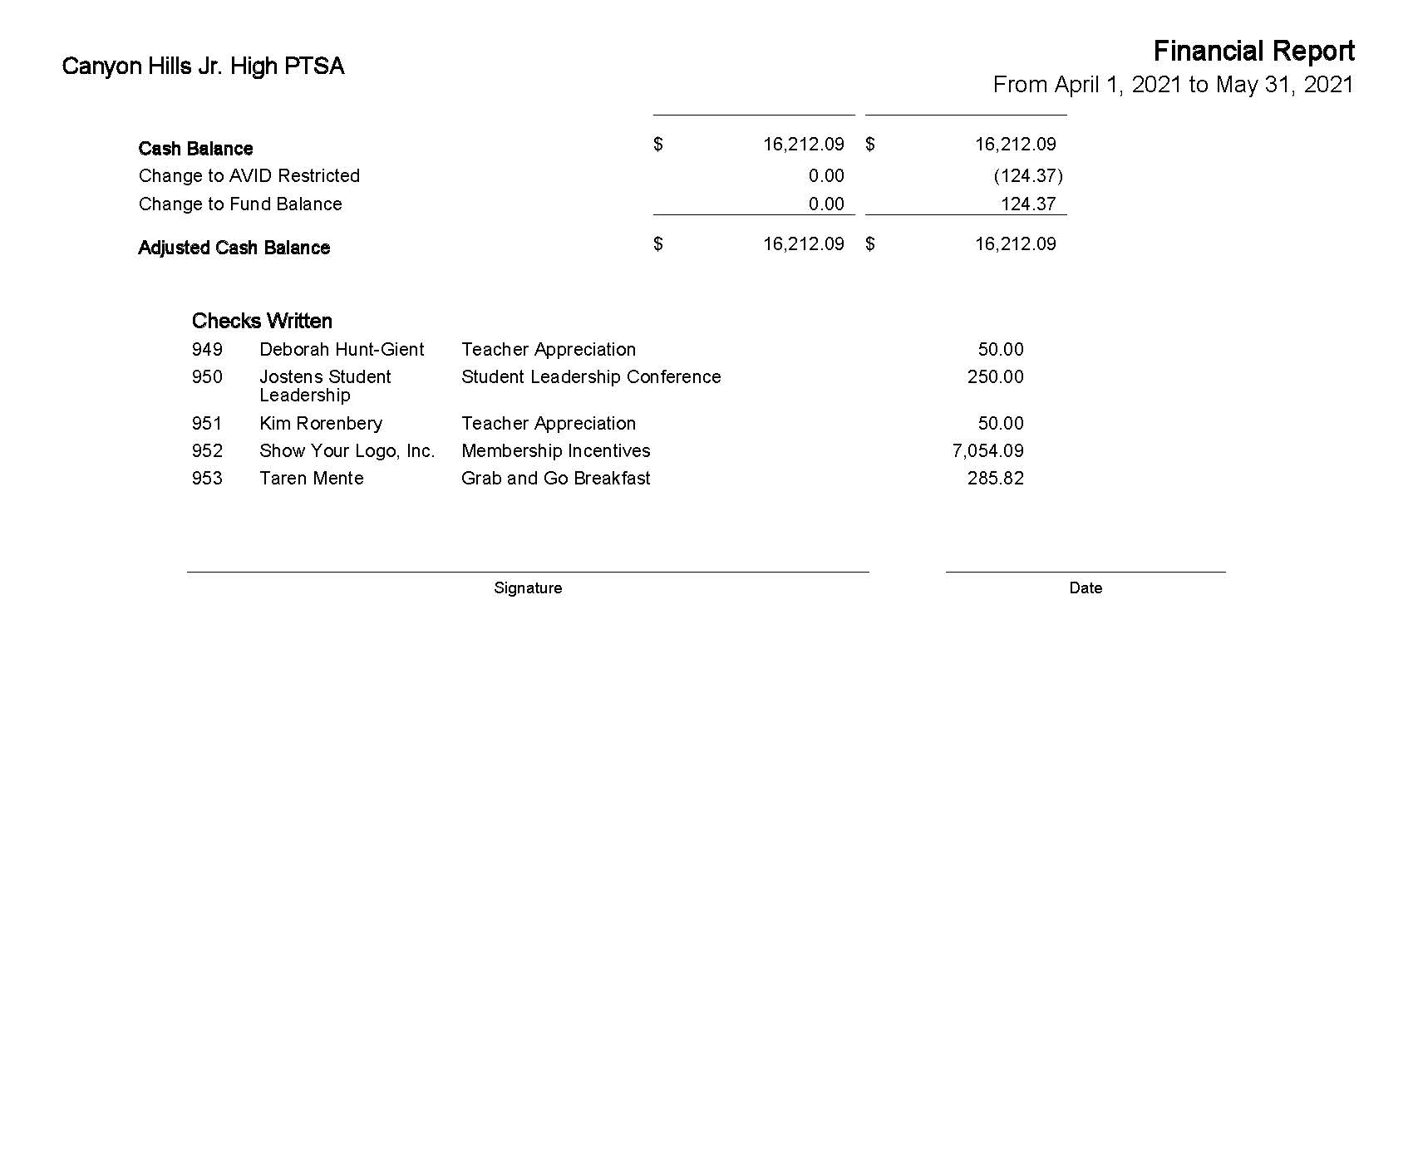

Slide 8
CHECK REQUESTS
National Junior Society $385.00
Website & Email $684.00
Teacher End of Year Grab & Go Breakfast $295.13

Slide 9
President’s Report

Slide 10
2021-2022 Executive Board
President
Rebecca Sabatino
Treasurer
Riza Erlandson
Secretary
Kelly Kwock
1st VP Membership
Inez Janecek
2nd VP Fundraising
Deborah Vargo
3rd VP Programs
Jennifer Delzell-Christos

Slide 11
2021-2022 Executive Board
Historian
Marta Deniger
Parliamentarian
Lesa Iasparro
Auditor
Open Position
Teacher Representative
Open Position
Students Representative
Open Position

Slide 12
COMMITTEE MEMBERS
SPIRIT WEAR
Kelly Kwock
AFTER SCHOOL & DANCE SNACKS
Open Position
HOSPITALITY
Taren Mente
BOOK FAIR
Leslie Miller

Slide 13
Executive Board Report

Slide 14
NEW SPIRIT WEAR

Slide 15
OLD SPIRIT WEAR

Slide 16
MEMBERSHIP INCENTIVES
MAROON (1) TARDY PASS Receive National benefits Support Students $15.00 | Cost $5.25 Profit $9.75
SILVER MAROON level Benefits PLUS... (1) FREE AFTER SCHOOL SNACK (1) HOMEWORK PASS $25.00 | Cost $8.00 Profit $17.00
GOLD SILVER level Benefits PLUS... (1) RUN PASS for PE Run $50.00 | Cost $8.00 Profit $42.00

Slide 17
MEMBERSHIP INCENTIVES
PLATINUM GOLD level Benefits PLUS... (1) $10.00 Book Fair Gift Certificate (1) Marquee Greeting (1) FRONT of the LINE PASS $100.00 | Cost $18.00 Profit $82.00
THE PUP PACKAGE Gold Membership Insulated Water Bottle T-Shirt $75 (SAVE $10) | Cost $30.00 Profit $45.00
Platinum Membership Insulated Water Bottle Hooded Sweatshirt T-Shirt $140 (SAVE $20) | Cost $50.00 Profit $90.00

Slide 18
Next Board Meeting July 14th @ 4:00 P.M.

Slide 19
Adjournment

